Slide 1

Learning to Enhance Low-Light Image via Zero-Reference Deep Curve Estimation
Chongyi Li
April 23, 2021
Learning to Enhance Low-Light Image via Zero-Reference Deep Curve Estimation, TPAMI, 2021
Zero-Reference Deep Curve Estimation for Low-Light Image Enhancement, CVPR, 2020
https://li-chongyi.github.io/Proj_Zero-DCE++.html

Slide 2
Outline
Part 1 – Background
Part 2 – Zero-DCE
Part 3 – Zero-DCE++
Part 4 – Experiments
Part 5 – Related Work

Slide 3
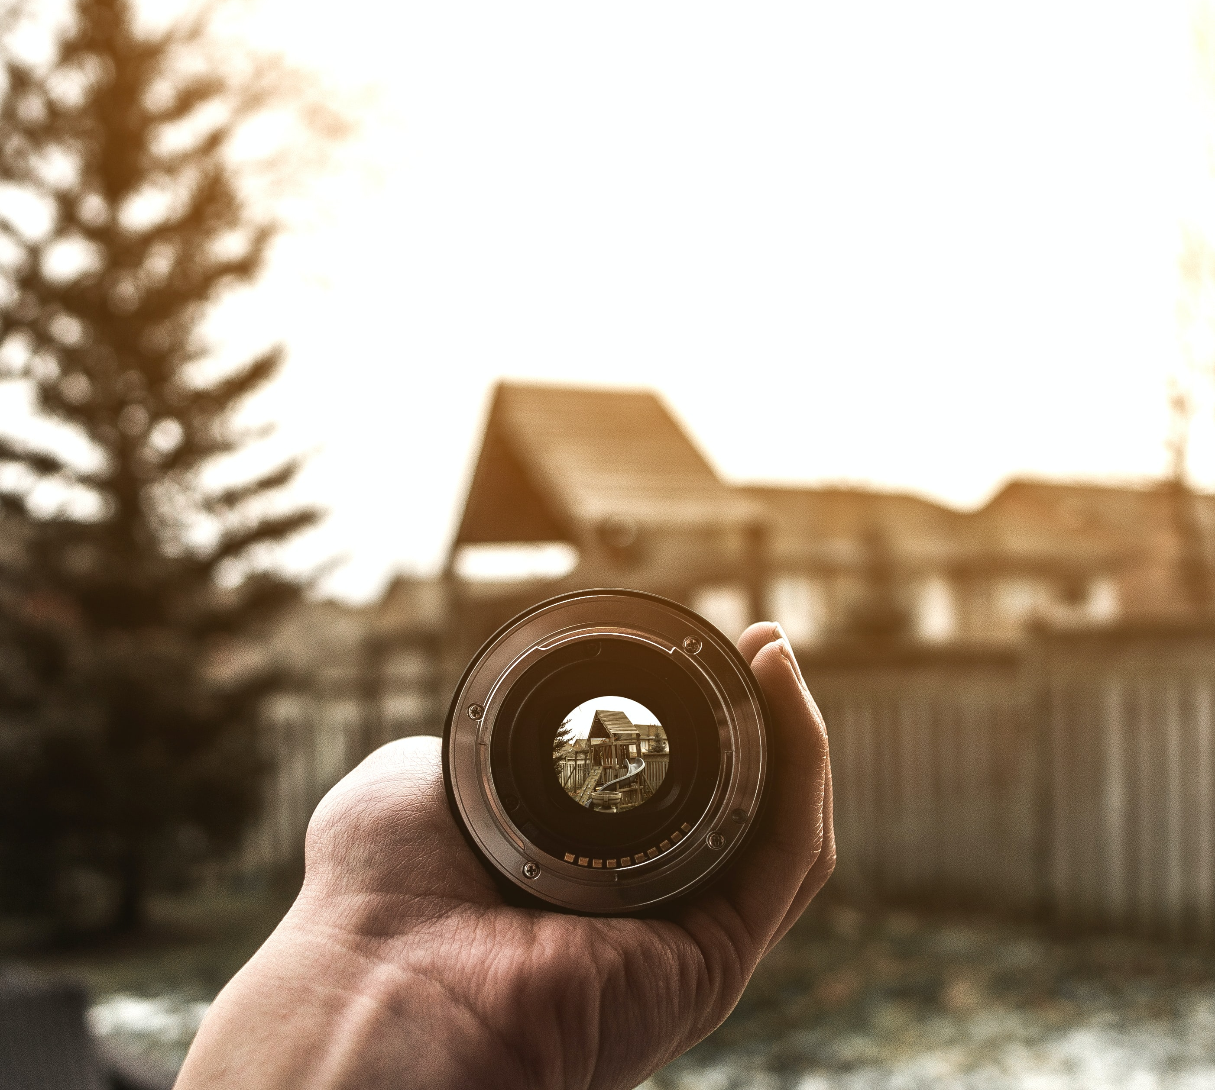
Part 1: Background

Slide 4
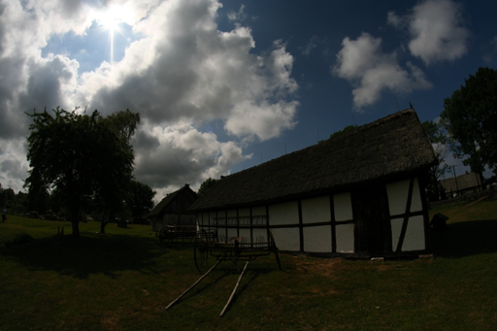
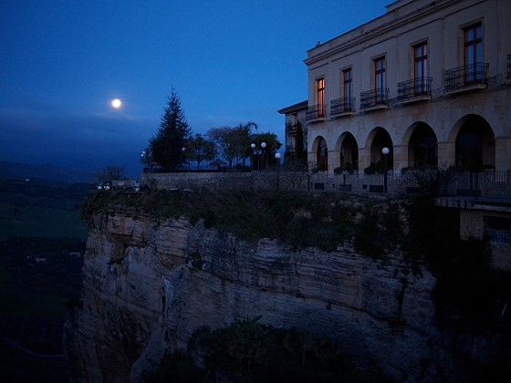
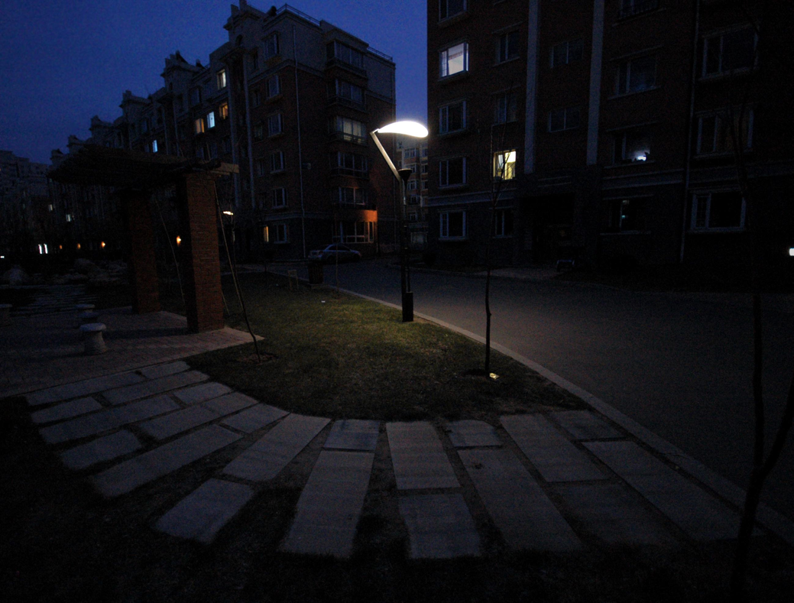
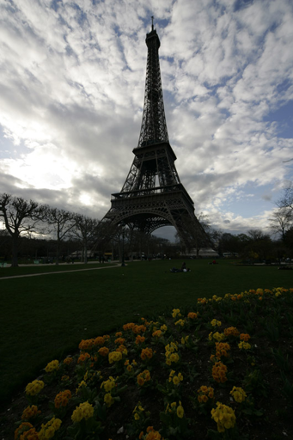
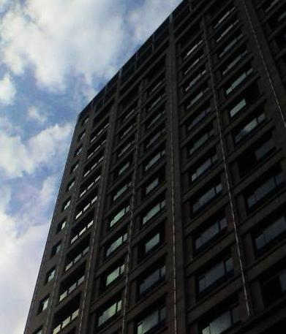
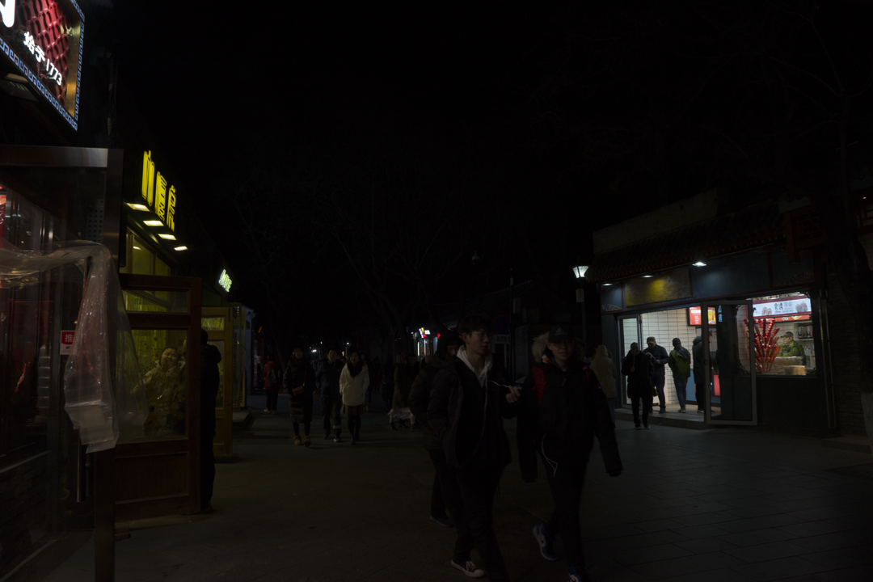
Low-Light Enhancement
Under-Exposure
Low Light

Slide 5
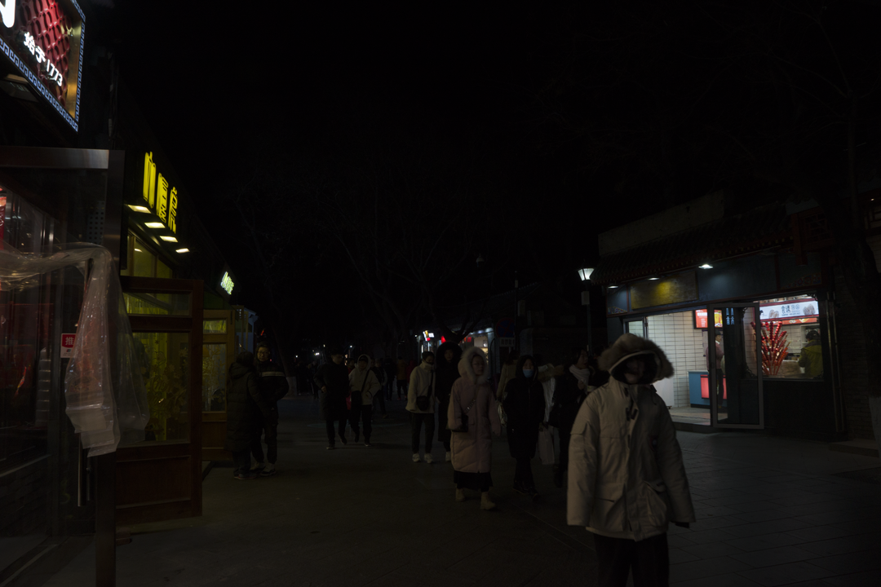
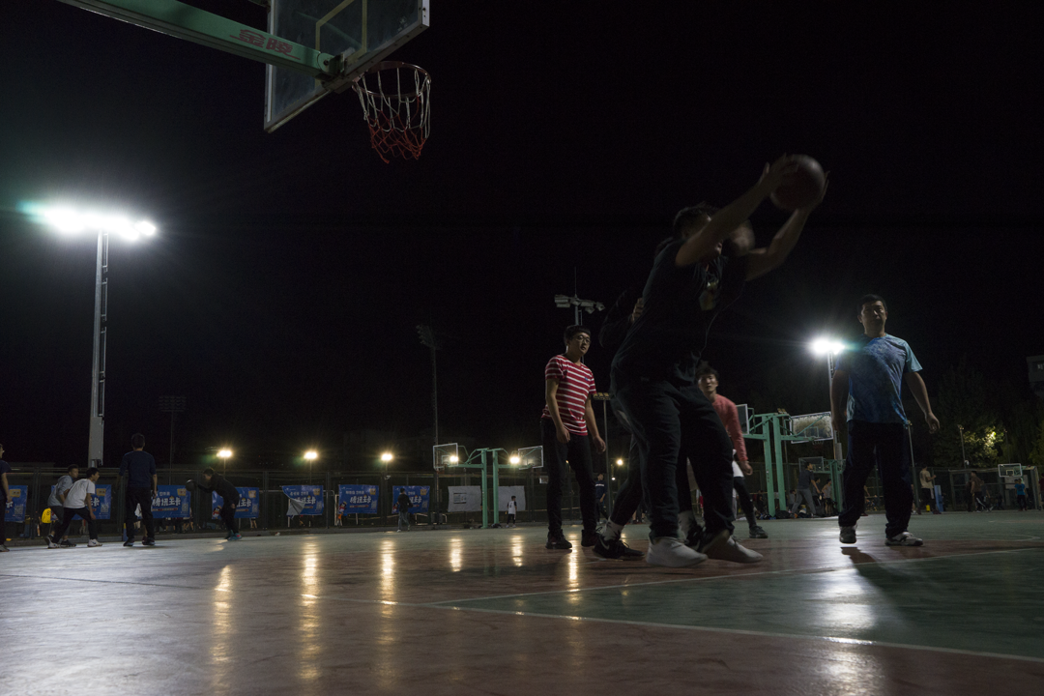
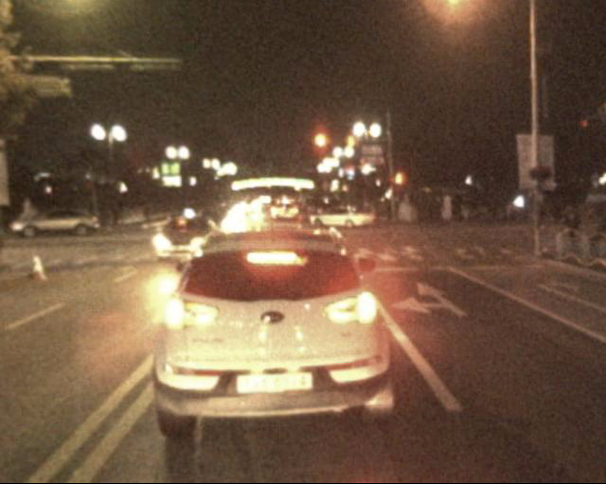
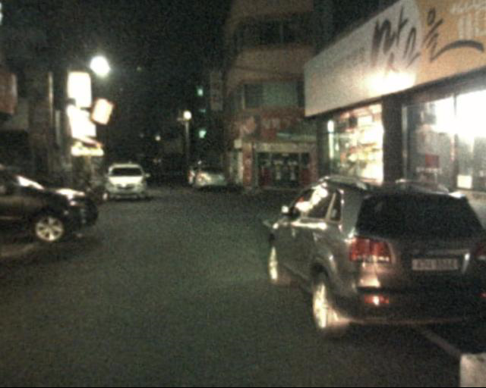
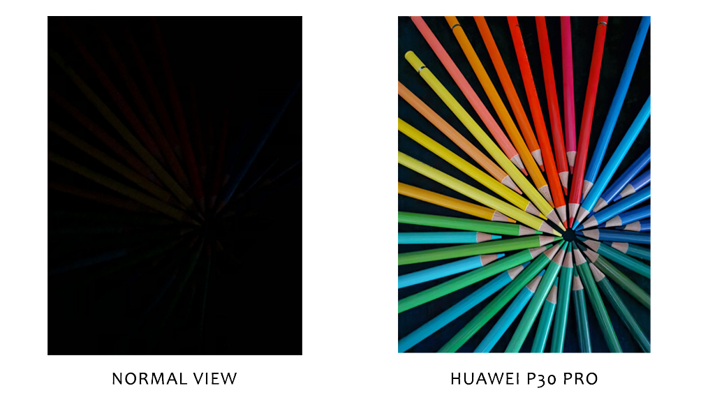
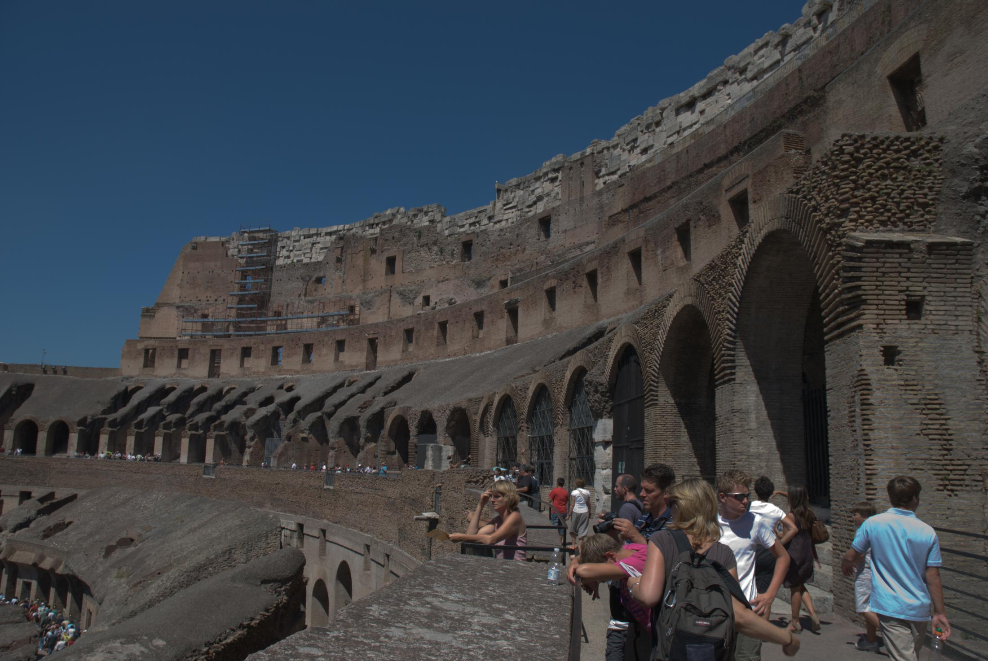
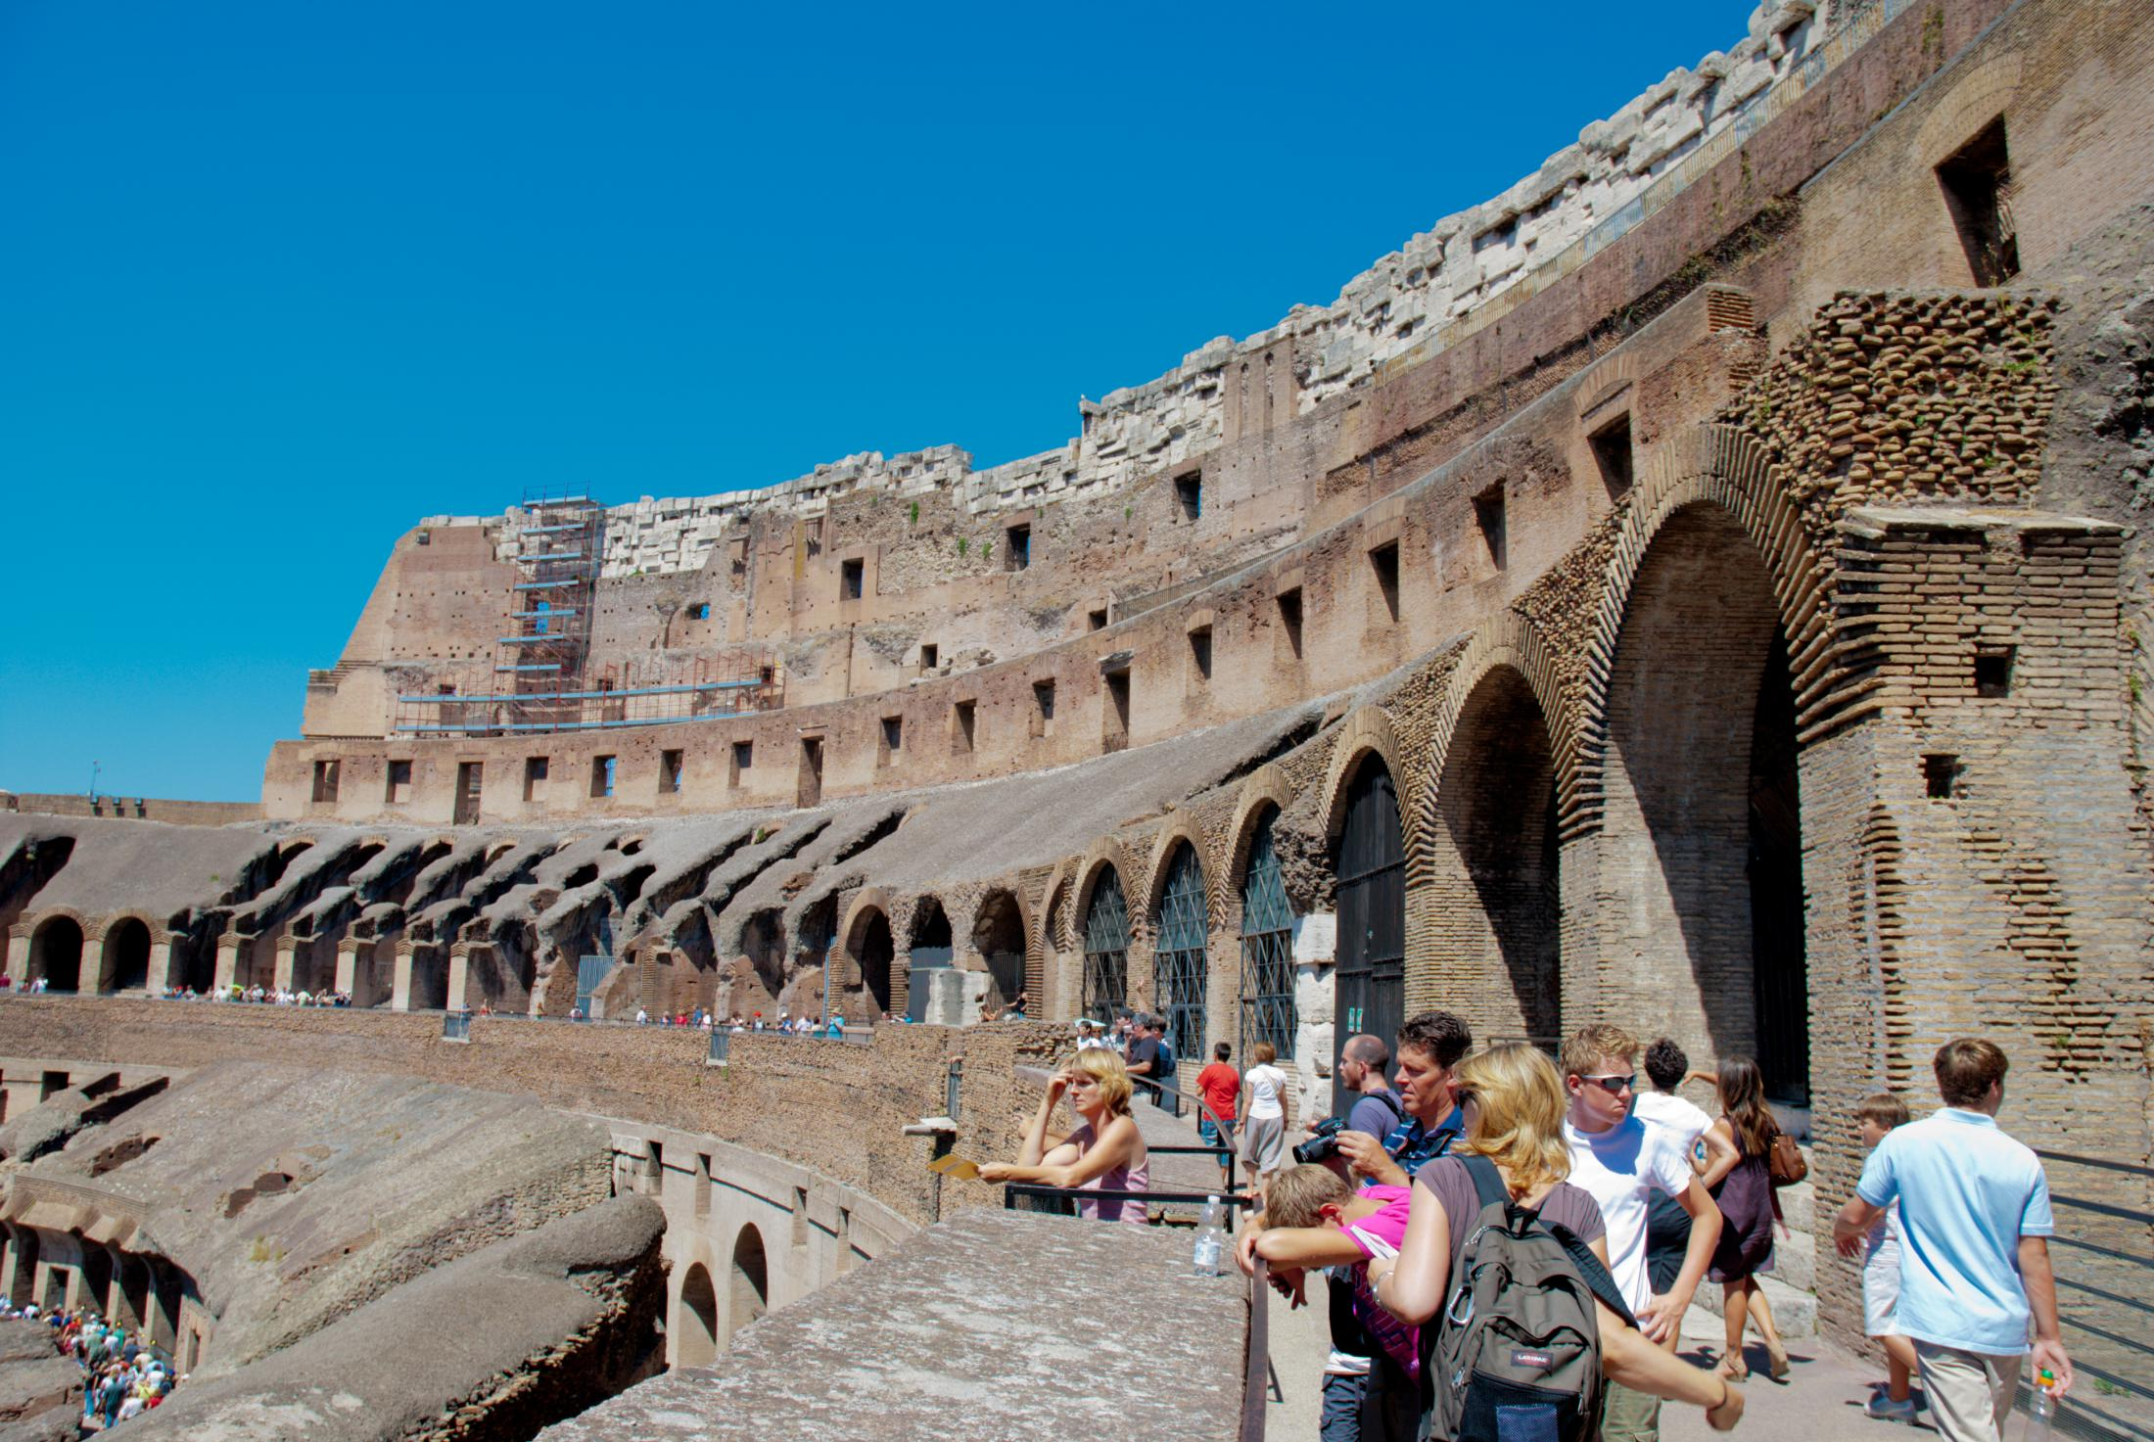
Applications
Detection and Recognition in the Dark
face
car
Photo Auto Editing
see the unsee in the dark

Slide 6
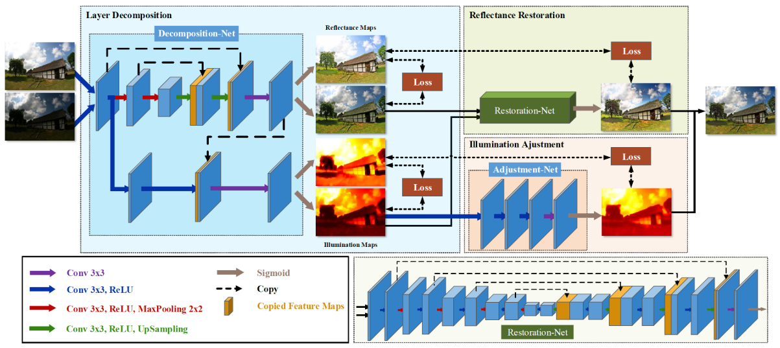
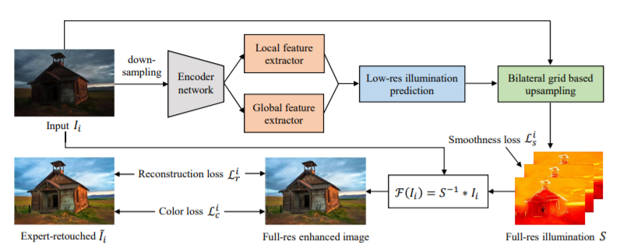
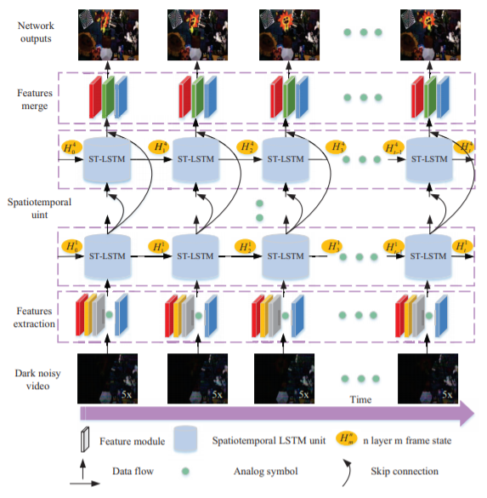
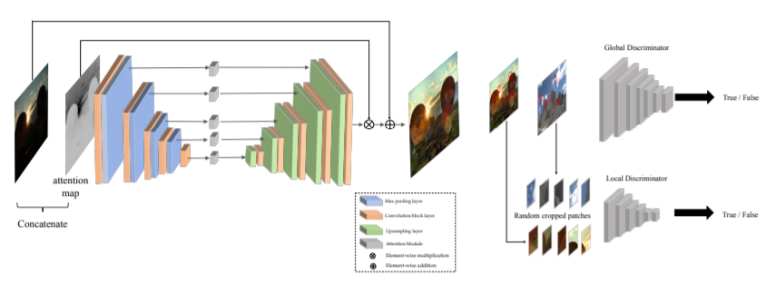
Network Structures
Zhang et al. ACMMM19
Wang et al. CVPR19
Wang et al. ICCV19
Jiang et al. TIP21

Slide 7
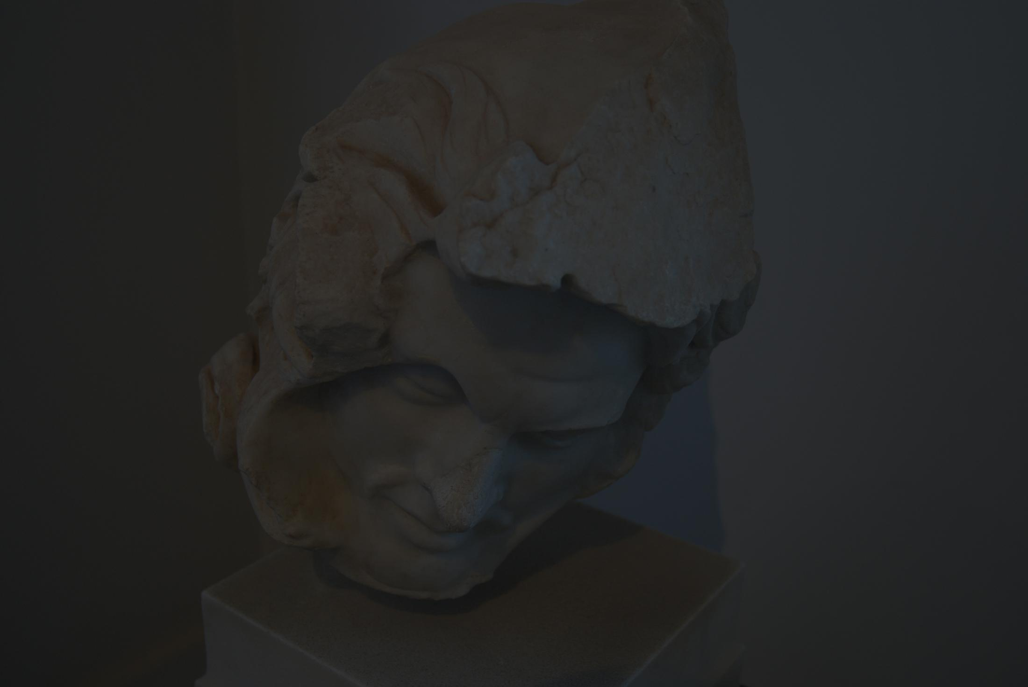
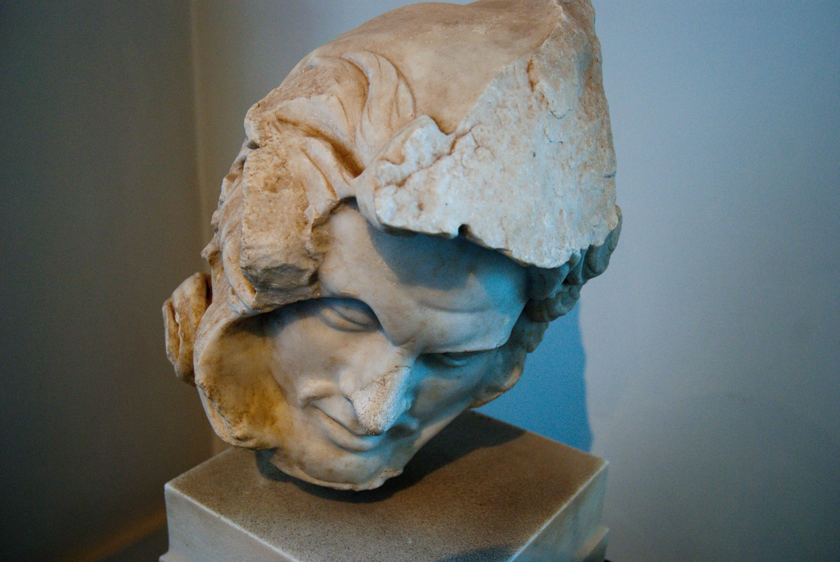
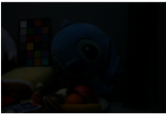

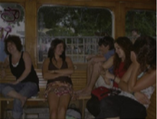
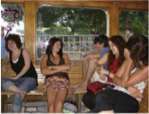
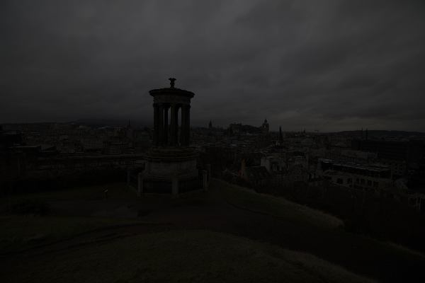
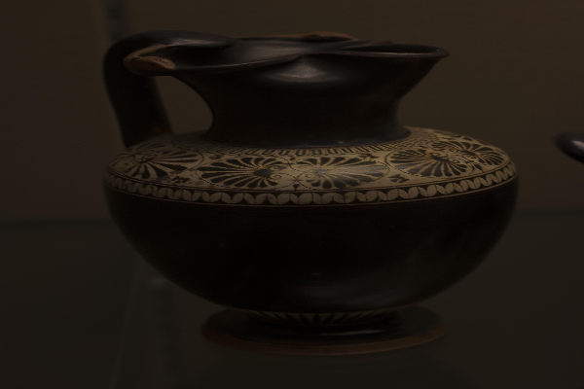
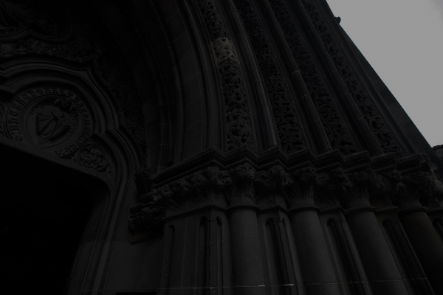
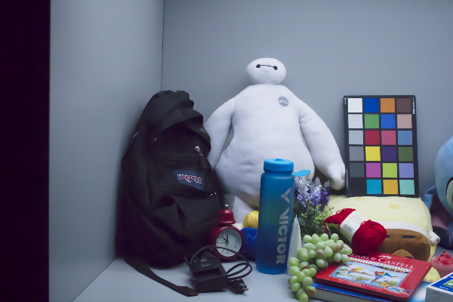
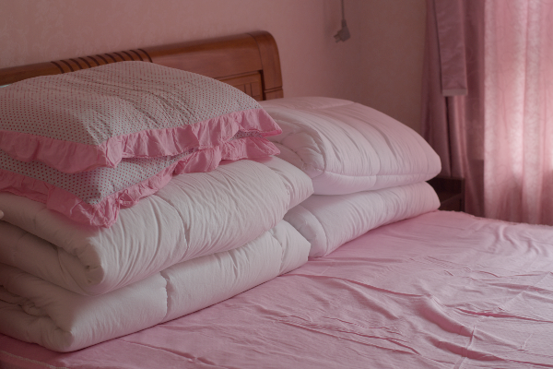
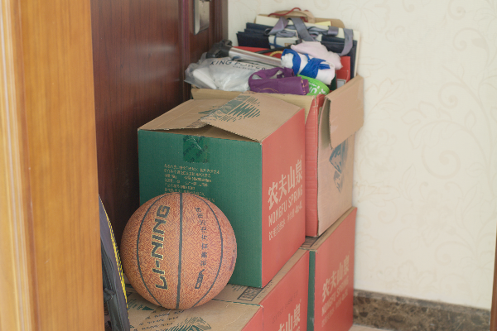
Training Data
Paired Training Data:
Retouching
Altering Exposure Time
Simulating
Unpaired Training Data:
Source
Target

Slide 8
Limitations
Inefficient: Require complex network structures
--> high computational burden
Sensitive: Rely on either synthesized or corrupted and clean image pairs
--> visually unpleasing results
Inflexible: Require careful selection of unpaired data and complex training
--> time-consuming training & hard to re-implement

Slide 9
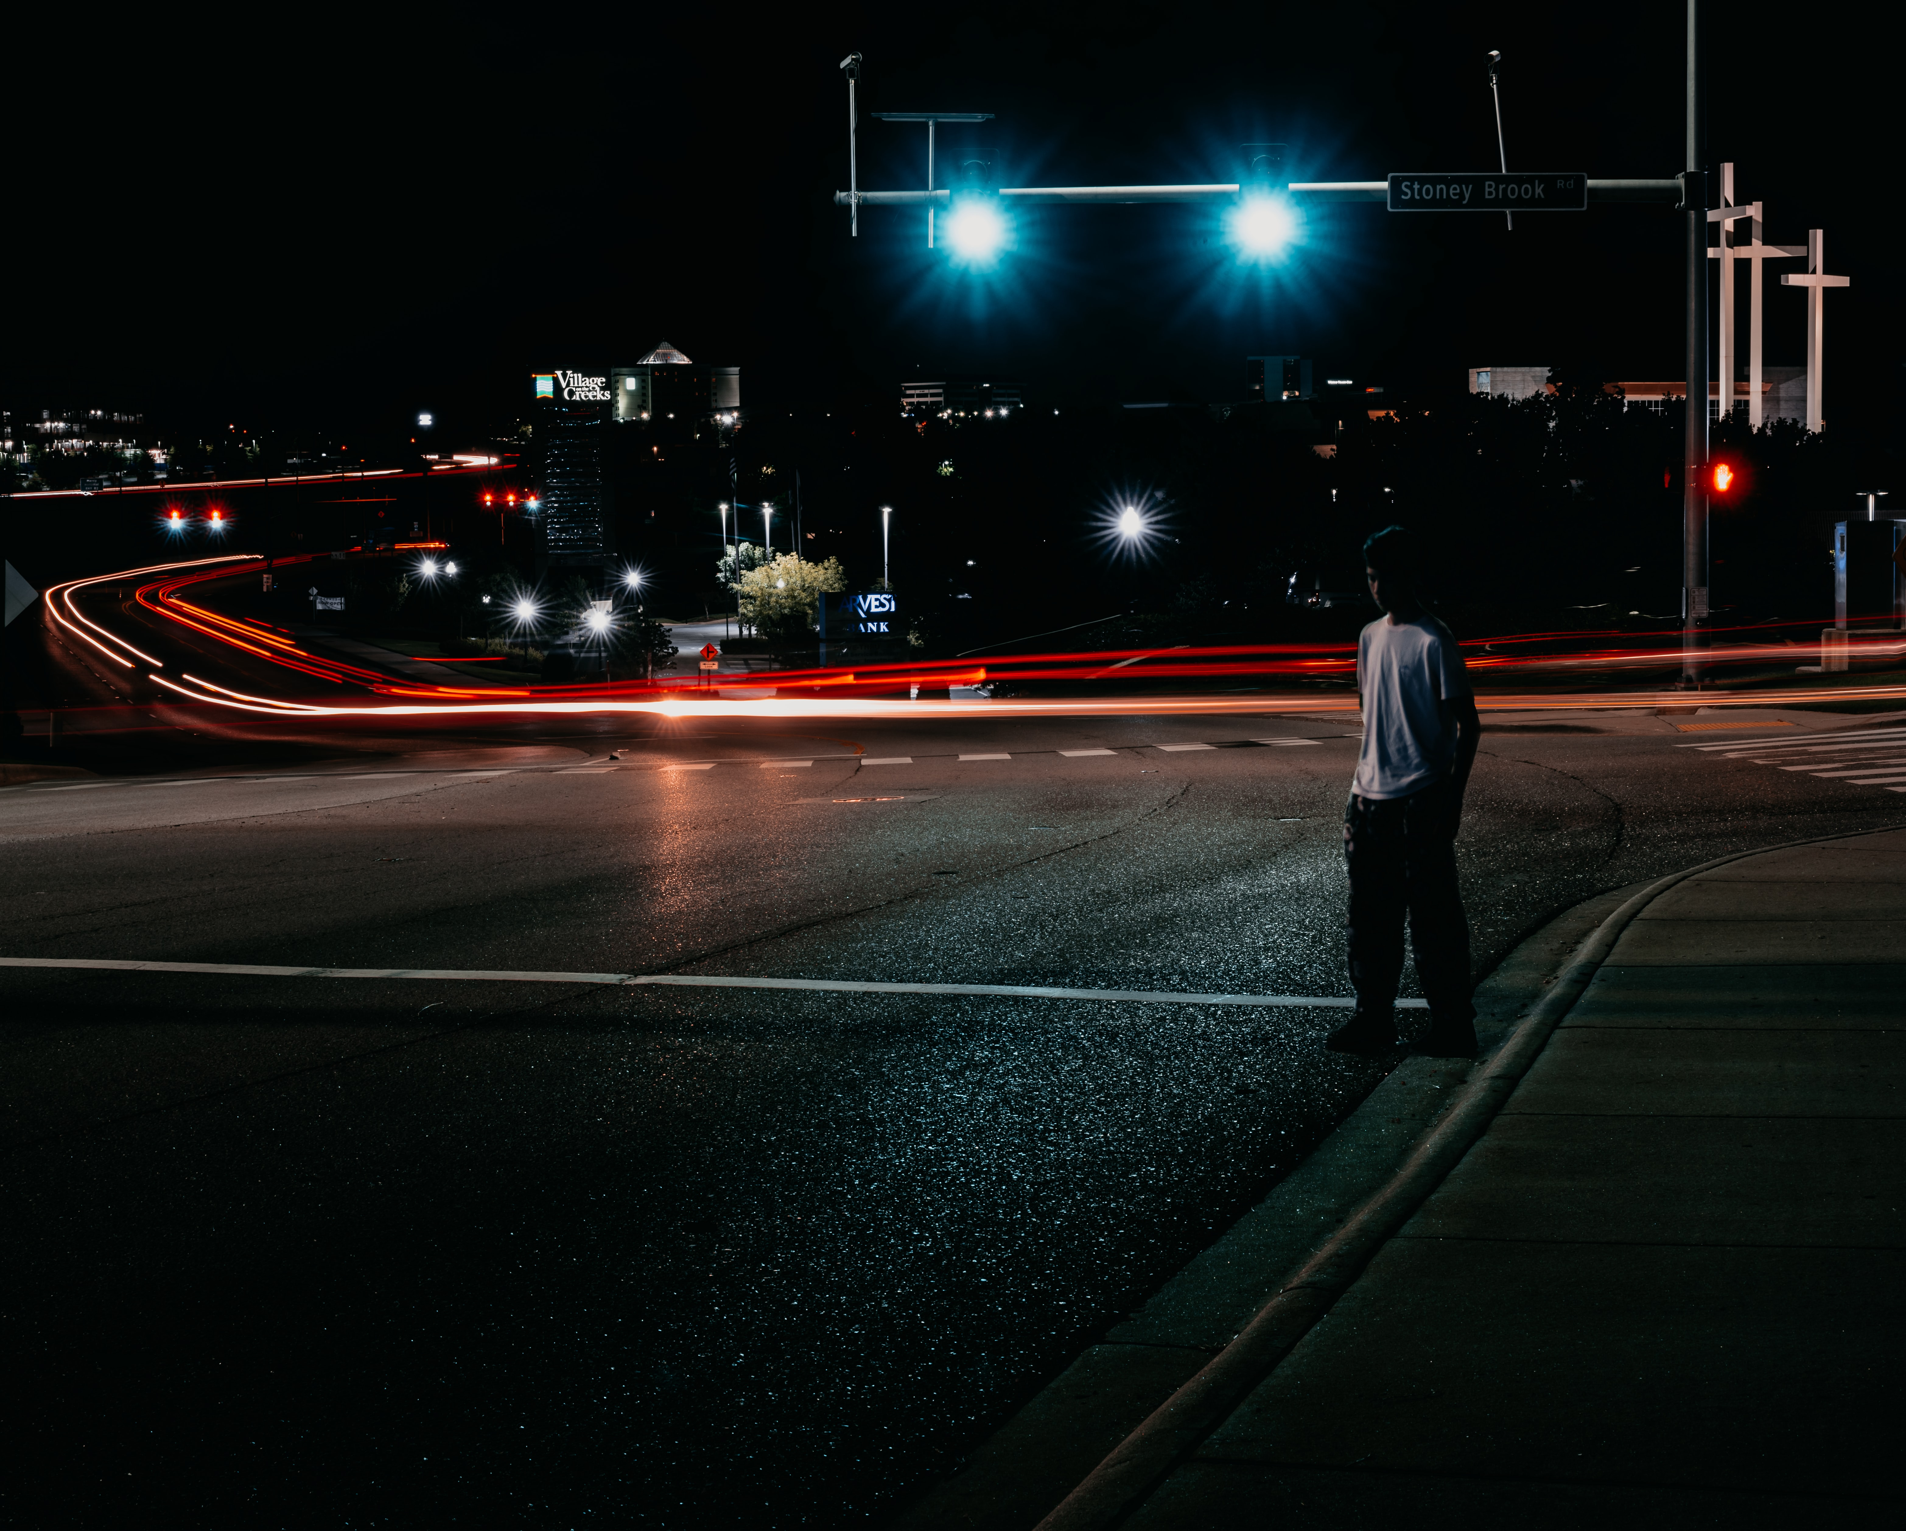
Part 2: Zero-DCE

Slide 10
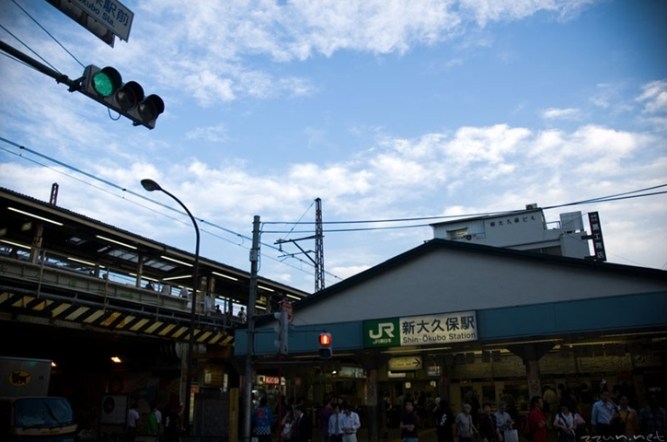
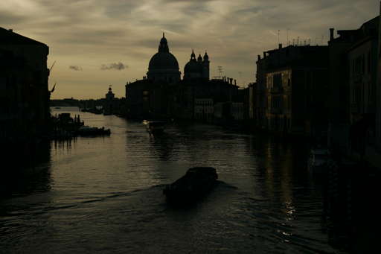
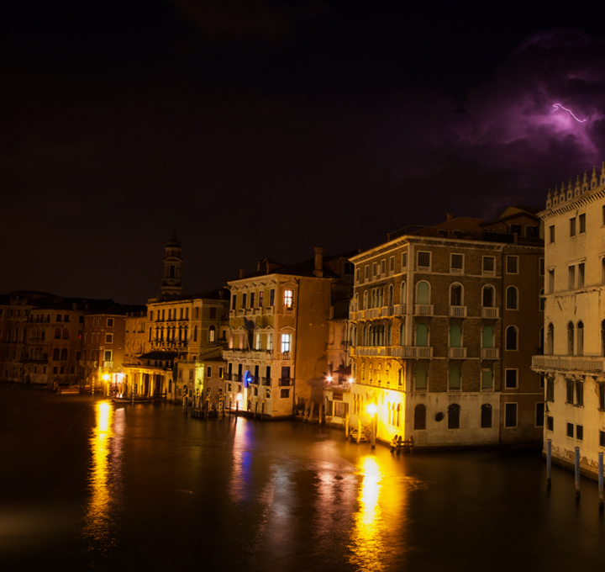
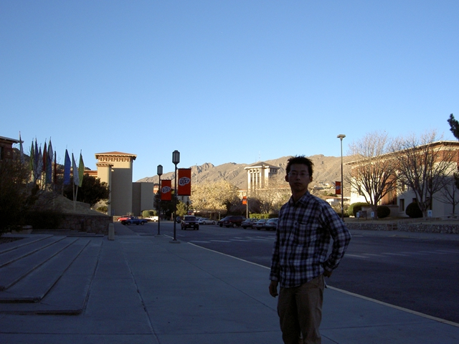
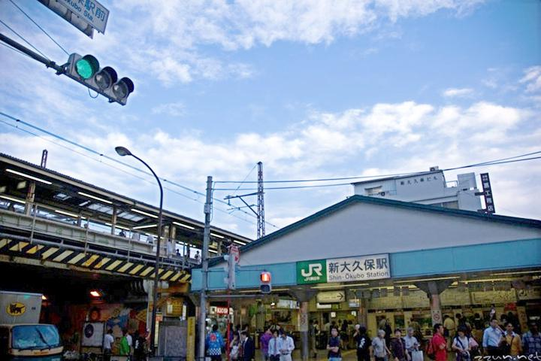
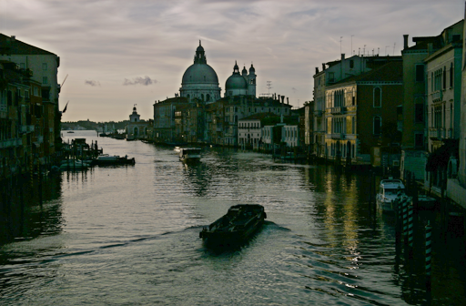
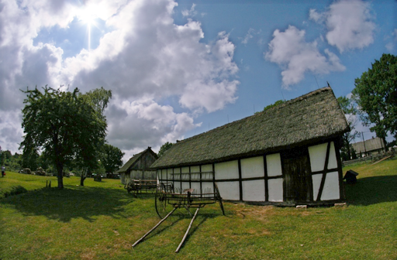
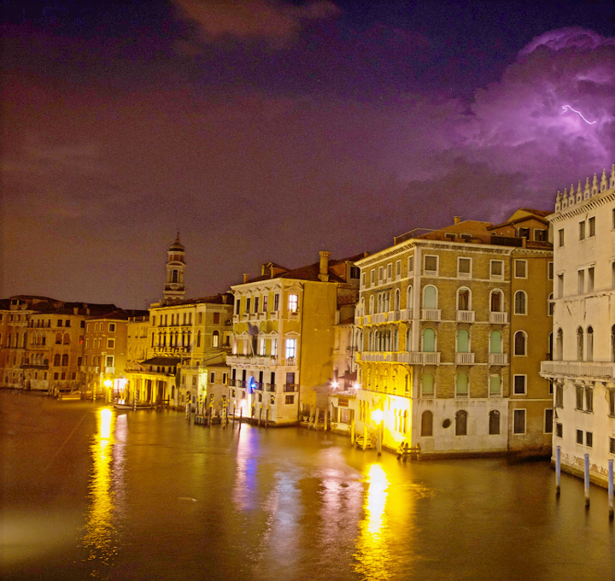
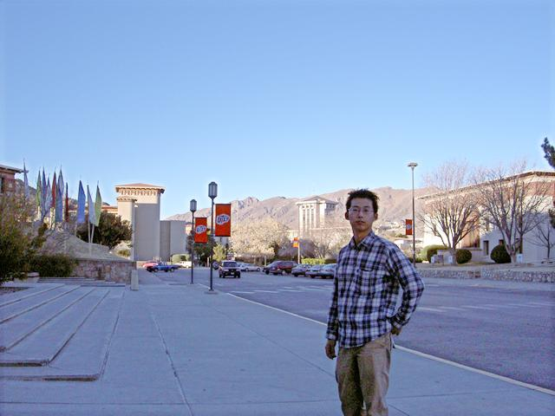
Zero-DCE
Low-Light
Zero-DCE

Slide 11
Zero-DCE
We propose a low-light enhancement network that is independent of paired and unpaired training data
--> avoid the risk of overfitting & generalize well to various lighting conditions
We design an image-specific curve that is able to approximate pixel-wise and high-order curves by iteratively applying itself
--> perform mapping within a wide dynamic range
We devise task-specific non-reference loss functions that indirectly evaluate enhancement quality
--> show the potential of training a deep model in the absence of reference images

Slide 12
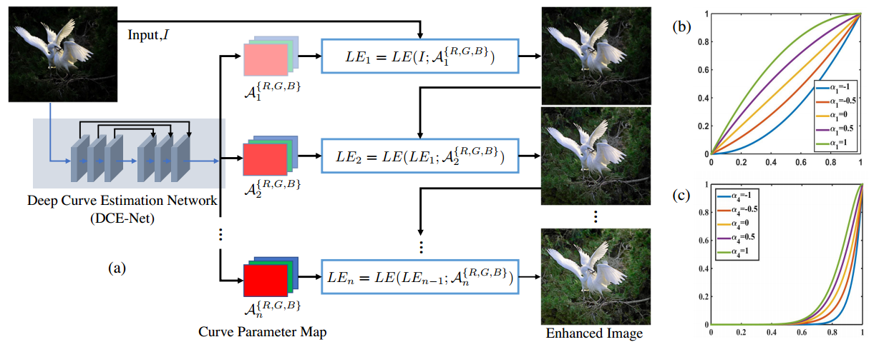
Zero-DCE

Slide 13
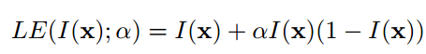
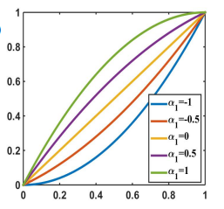
Light-Enhancement Curves (LE-Curves)
enhanced
low-light
trainable curve parameter [-1, 1]
LE-Curves

Slide 14
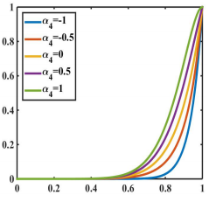
High-Order LE-Curves
the number of iteration
n=1
High-Order LE-Curves

Slide 15
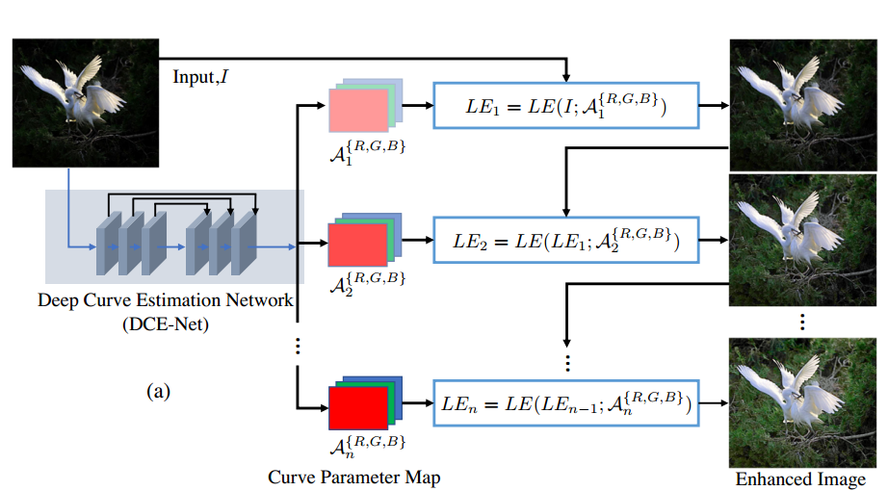
High-Order LE-Curves

Slide 16
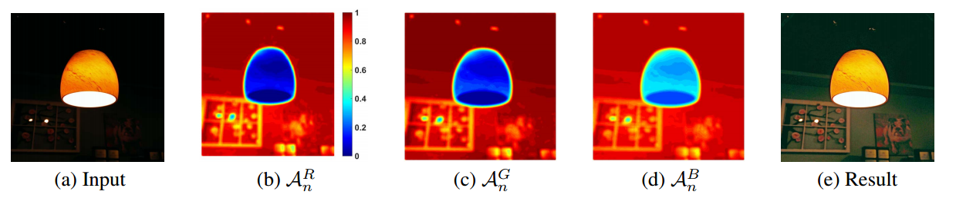
Pixel-Wise High-Order LE-Curves
parameter map with the same size as the given image

Slide 17
Pixel-Wise High-Order LE-Curves

Slide 18
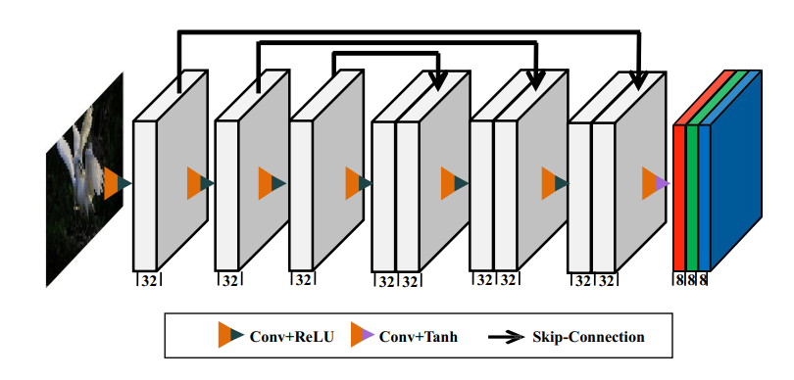
Deep Curve Estimation Network (DCE-Net)
24 parameter maps for 8 iterations
DCE-Net: 79,416 trainable parameters, and 5.21G FLOPs for an input image of size 256×256

Slide 19
Non-Reference Loss Functions
Spatial Consistency Loss
Exposure Control Loss
Color Constancy Loss
Illumination Smoothness Loss

Slide 20
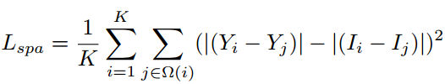
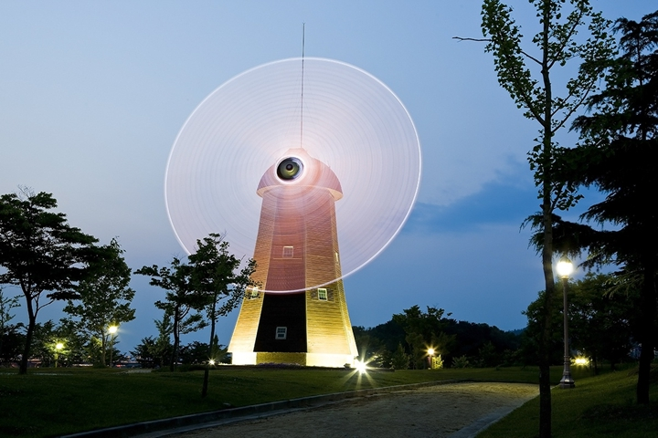
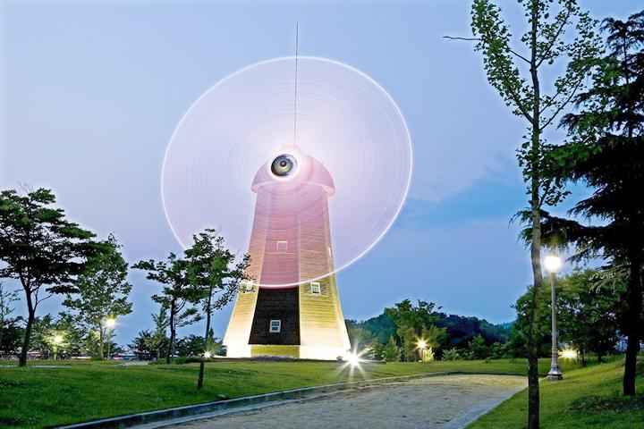
Spatial Consistency Loss
4
4
4
4
low-light
enhanced

Slide 21
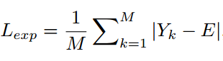
Exposure Control Loss
16
16
enhanced

Slide 22
Color Constancy Loss

Slide 23


Illumination Smoothness Loss

Slide 24

Part 3: Zero-DCE++

Slide 25

Zero-DCE++
Redesign Network Structure
Reformulate Curve Formation
Control Sizes of Input Image

Slide 26
Redesigned Network
Convolutional Layers --> Depthwise Separable Convolution Layers

Slide 27

Reformulated Curve Formation

Slide 28


Control Sizes of Input Image

Slide 29
Zero-DCE VS. Zero-DCE++
Zero-DCE
Trainable Parameters: 79K
FLOPs: 84.99 G (1200×900×3)
Runtime: 500 FPS (1200×900×3)
Training Time: 30 minutes
Zero-DCE++
Trainable Parameters: 10K
FLOPs: 0.115 G (1200×900×3)
Runtime: 1000 FPS (1200×900×3)
Training Time: 20 minutes

Slide 30

Part 4: Experiments

Slide 31

Low-Light Scene
Zero-DCE

Slide 32

first 100 frames for training
Low-Light Scene
Zero-DCE

Slide 33

Advantage of Three-Channel Adjustment

Slide 34

Impact of Training Data

Slide 35

Effect of Parameter Settings

Slide 36

Effect of Well-Exposedness Level

Slide 37

Comparisons

Slide 38

Comparisons

Slide 39

Comparisons

Slide 40

Comparisons

Slide 41

Comparisons

Slide 42


Comparisons

Slide 43

Part 5: Related Work

Slide 44


Related Work
Flexible Piecewise Curves Estimation for Photo Enhancement
https://arxiv.org/pdf/2010.13412.pdf
Input image
Enhanced image
(a) FlexiCurve -trained with paired data
(b) FlexiCurve -trained with unpaired data

Slide 45

Related Work
Lighting the Darkness in the Deep Learning Era (NTU&Nankai&SenseTime)
Project Page: https://github.com/Li-Chongyi/Lighting-the-Darkness-in-the-Deep-Learning-Era-Open/
LoLi-Platform: http://mc.nankai.edu.cn/ll/

Slide 46
Thank you!

